Slide 1
Random Forest on IT Salary Dataset
Carl ‘Andrew’ Perkins
Western Governors University
Notes:
ID=d924773e-9a16-4d6d-9803-8cb819e99682 Recipe=text_billboard Type=TextOnly Variant=0 FamilyID=AccentBoxWalbaum_Zero

Slide 2

Introduction
Andrew Perkins
10+ years in leadership experience
5 years experience with data science within healthcare
Bachelors of Science in Data Management/Analytics from Western Governors University(WGU)
Graduate student at WGU for Data Analytics
Employed by large health care payer organization and also CEO/Founder of Data Consulting Firm, AP Datum

Slide 3

Agenda
Research Problem and Hypothesis
Tools and Limitations
Data Collection and Context
Data Preparation and Analysis
Findings
Proposed Actions
Data Professional Salary Prediction Tool
Summary of Benefits

Slide 4
Research Question: Can a Random Forest model be constructed based upon the survey salary dataset? Hypothesis: A Random Forest can be constructed on the survey salary dataset.
Research Problem and Hypothesis

Slide 5
Tools and Limitations
Python -- tool
Dataset only contains four years of salary data, roughly 8k rows of data
The dataset is a survey which can lead to inconsistent and erroneous data
There were several years that produced differing questions, in effect producing missing data

Slide 6
Data Collection and Context
Dataset is a survey of Data Professional salaries collected and made publicly-available by Brent Ozar Unlimited
Simply downloaded dataset by clicking on link via Brent Ozar’s site
https://www.brentozar.com/archive/2020/01/the-2020-data-professional-salary-survey-results-are-in/

Slide 7
Data Preparation and Analysis
Normality test conducted on several variables
Missing values imputed
Extreme outliers were removed
Supervised and Unsupervised techniques were used
Beginning data sparsity was 24% -- this indicates that around 1/4th of the starting dataset isn’t helpful

Slide 8
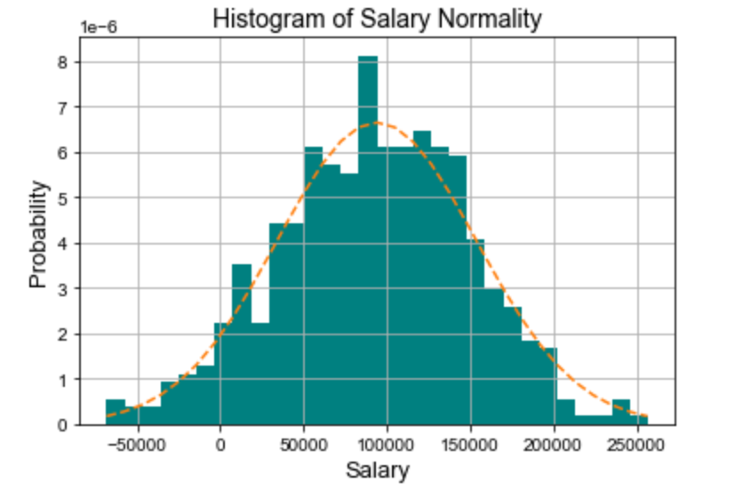
Data Preparation and Analysis (continued)
Salary Variable
The histogram to the left indicates that the salary variable has a normal distribution. This is found by the normal-distributive bell curve that the bins of the dataset sample fit within. This helps us to understand the target variable itself.

Slide 9
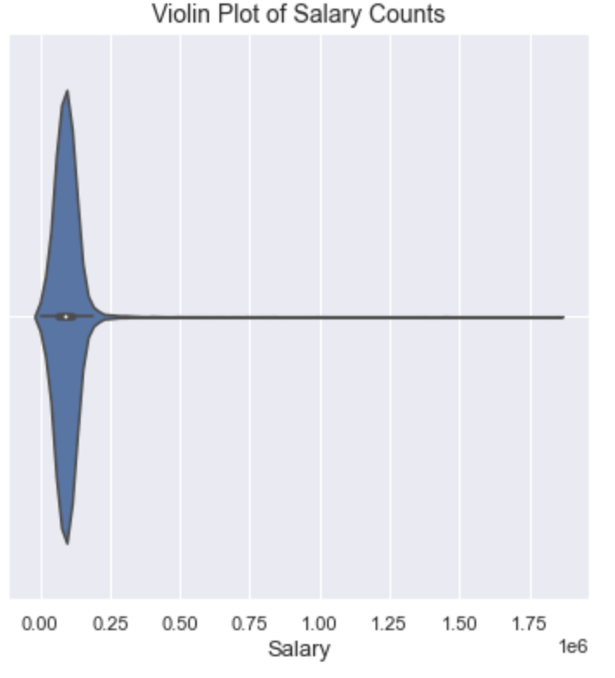
Data Preparation and Analysis (continued)
Salary Variable
The violin plot to the left shows that the salary variable has extreme outliers, indicated by the long horizontal line.

Slide 10
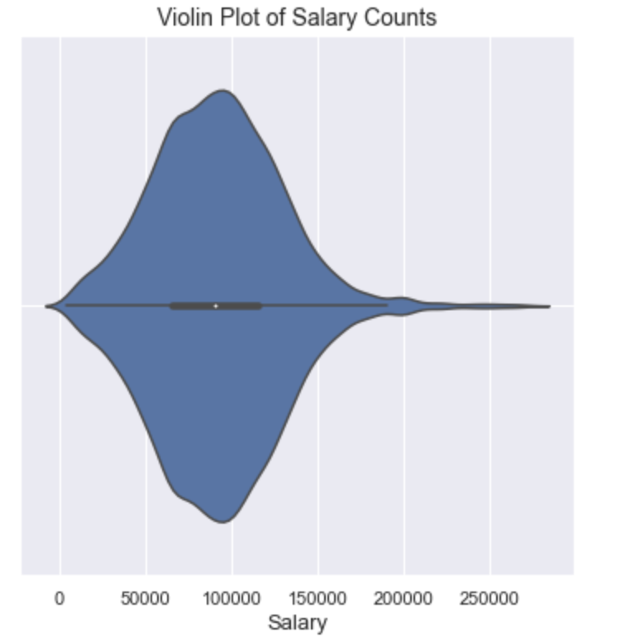
Data Preparation and Analysis (continued)
Salary Variable
Violin plot after extreme outliers were removed from salary variable. Much better!

Slide 11
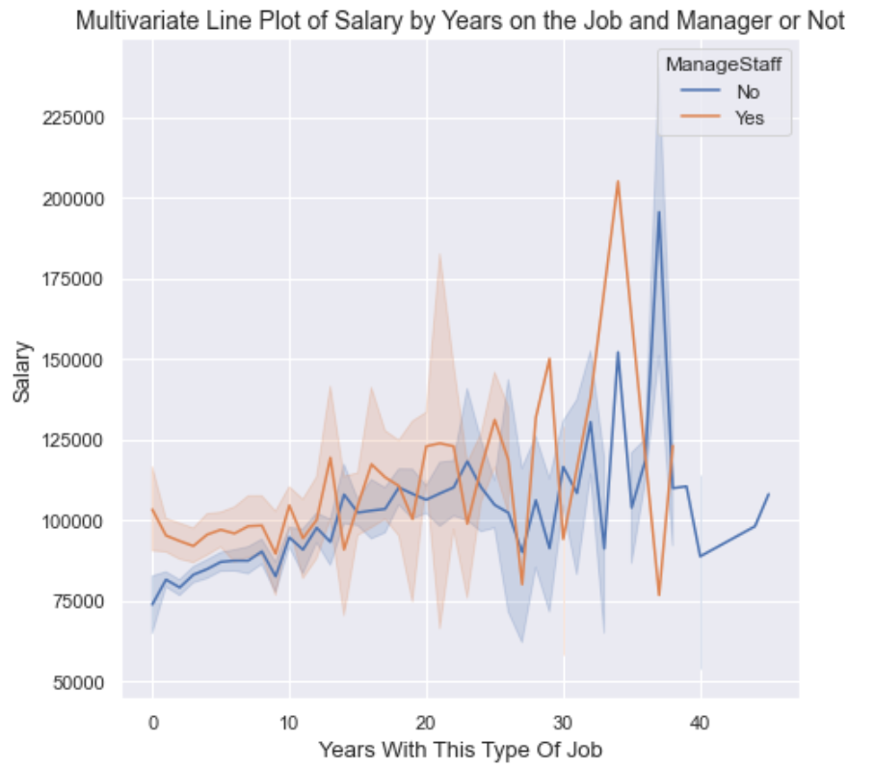
Data Preparation and Analysis (continued)
Salary Multivariate Analysis
As expected, with more experience, salary increases on average.

Slide 12
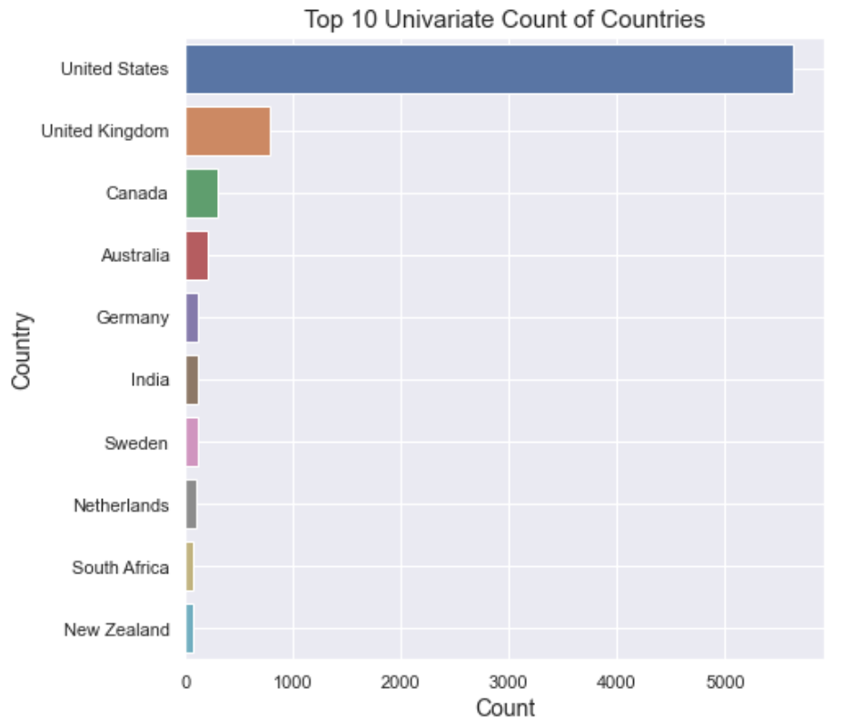
Data Preparation and Analysis (continued)
Country Variable
U.S. has the most survey submissions.

Slide 13
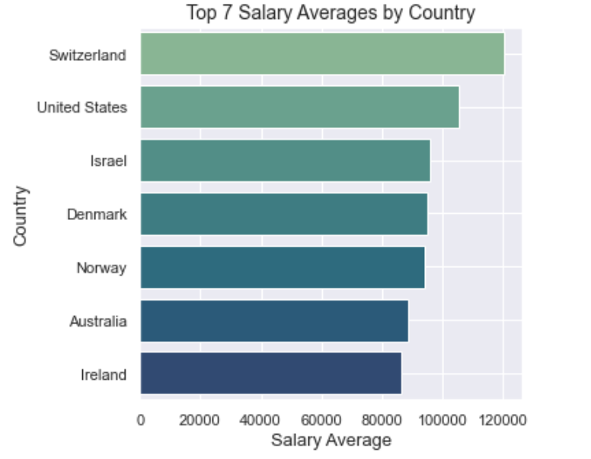
Data Preparation and Analysis (continued)
Country by Salary Average
Switzerland and the U.S. have the highest salary averages. Because of the small count from Switzerland, this likely skewed the data.

Slide 14
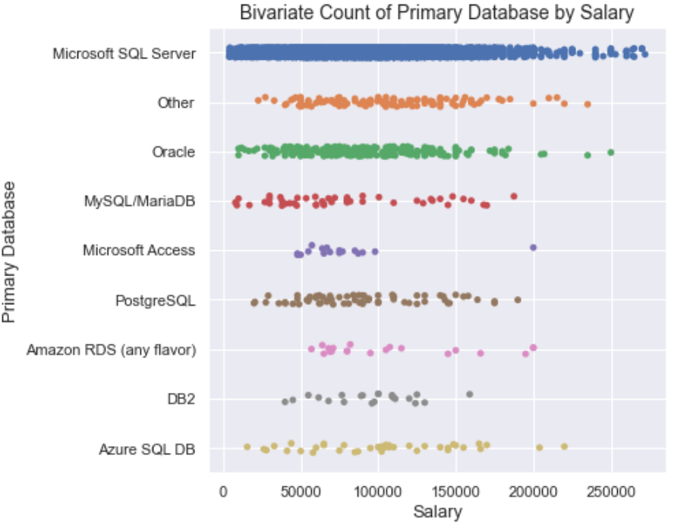
Data Preparation and Analysis (continued)
Primary Database by Salary Count
Microsoft’s database system has the most survey submissions.

Slide 15
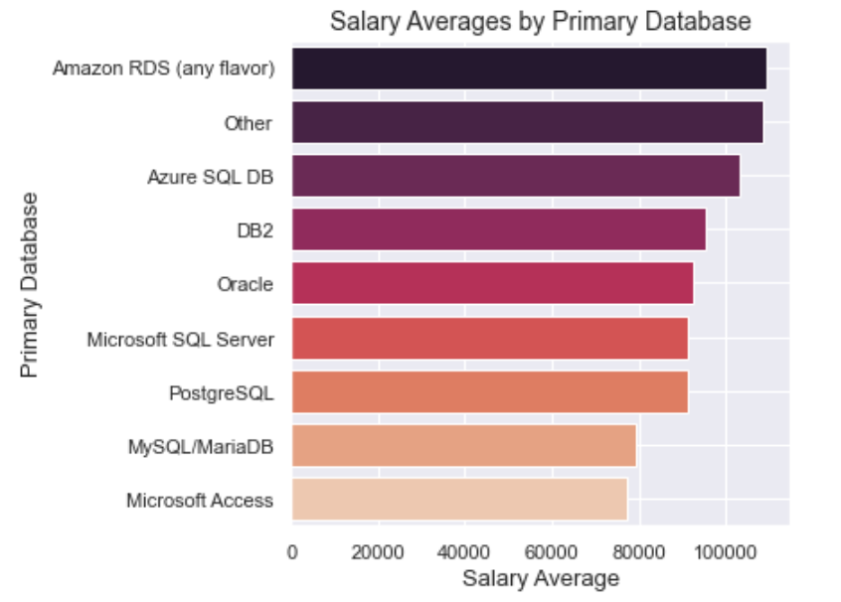
Data Preparation and Analysis (continued)
Primary Database by Salary Average
The highest paying salary average is of the Amazon variety.

Slide 16
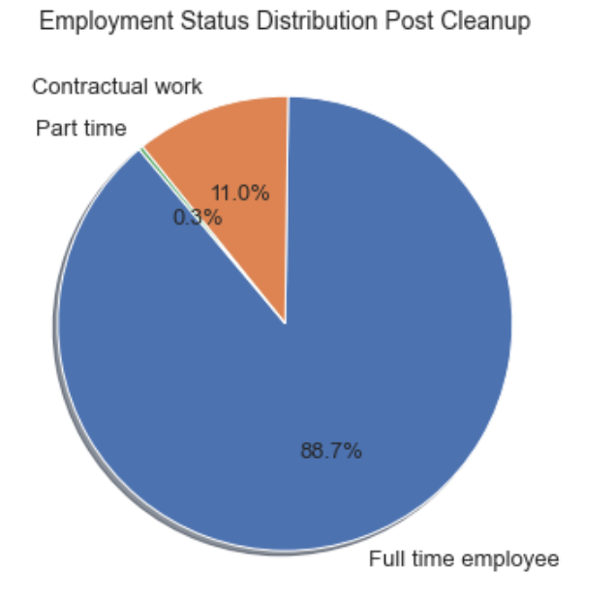
Data Preparation and Analysis (continued)
Employment Status Variable
Most survey applicants are full time employees.

Slide 17
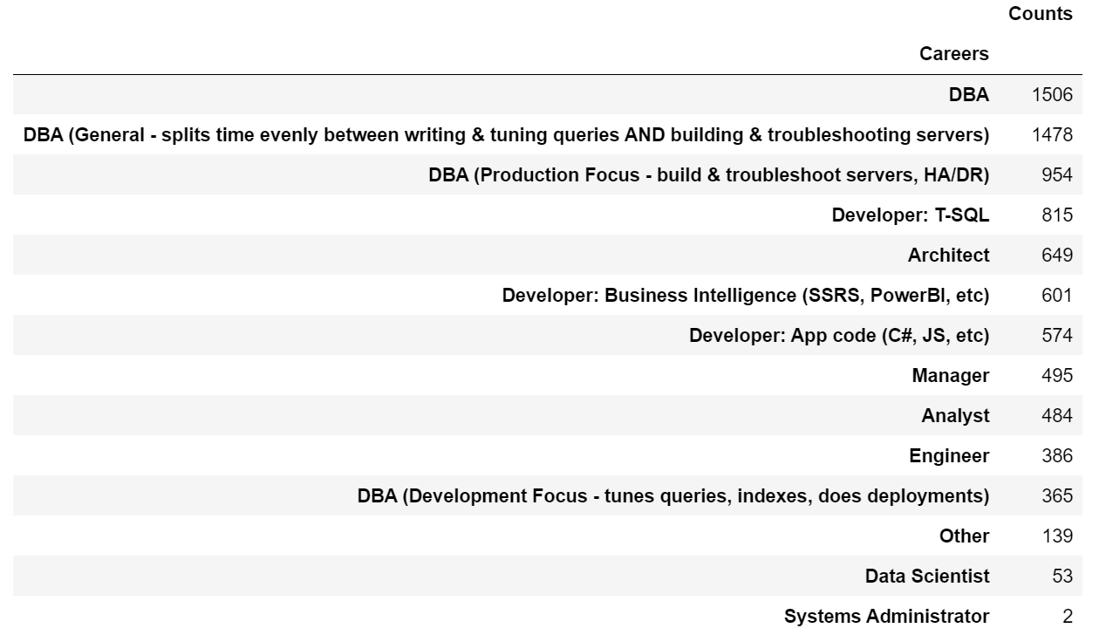
Data Preparation and Analysis (continued)
Career Variable
Most survey applicants are Database Administrators.

Slide 18
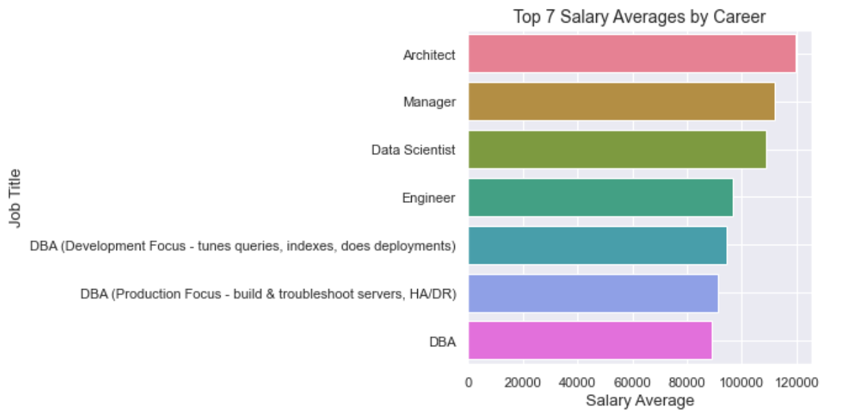
Data Preparation and Analysis (continued)
Career by Salary Average
Architects and Managers make the most on average.

Slide 19
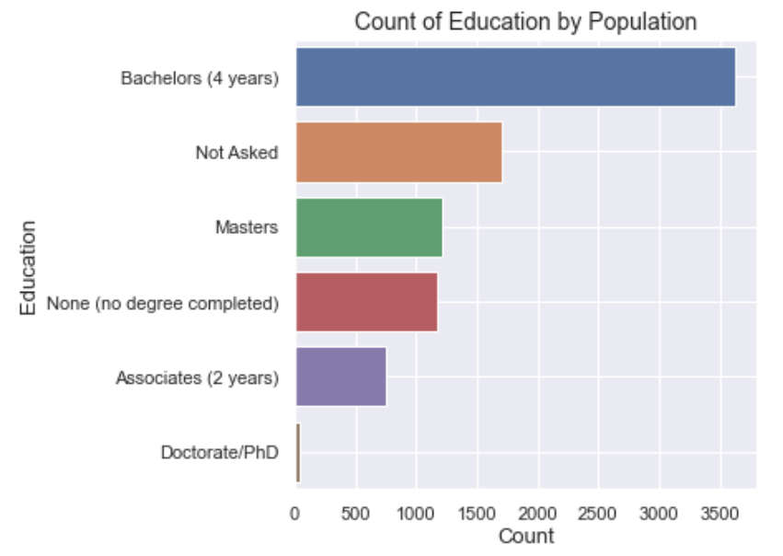
Data Preparation and Analysis (continued)
Education Variable
Most survey applicants had a bachelors degree. Note the “not asked” is an example of a missing value.

Slide 20
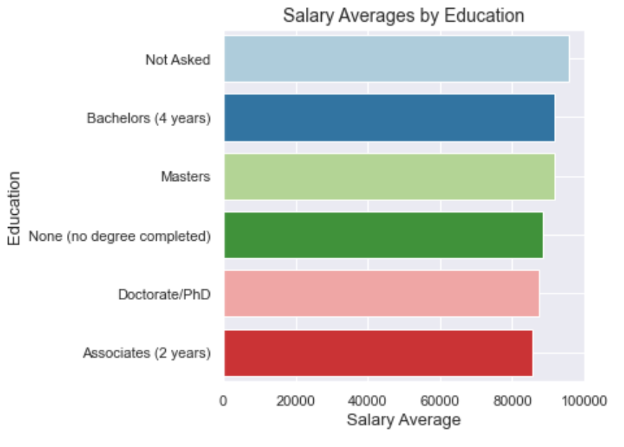
Data Preparation and Analysis (continued)
Education by Salary Average
Not much difference in salary average between Masters and Bachelors degree. Interesting!

Slide 21
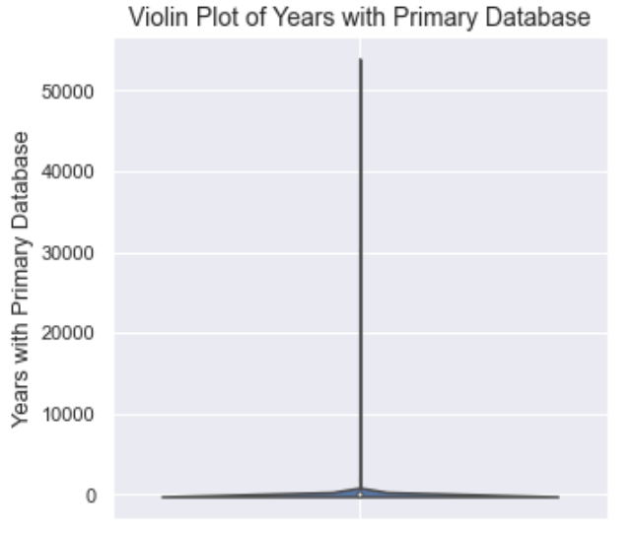
Data Preparation and Analysis (continued)
Years with Database Variable
The violin plot to the left indicates that the years with database variable has extreme outliers. As before, the vertical horizontal line is the indicator.

Slide 22
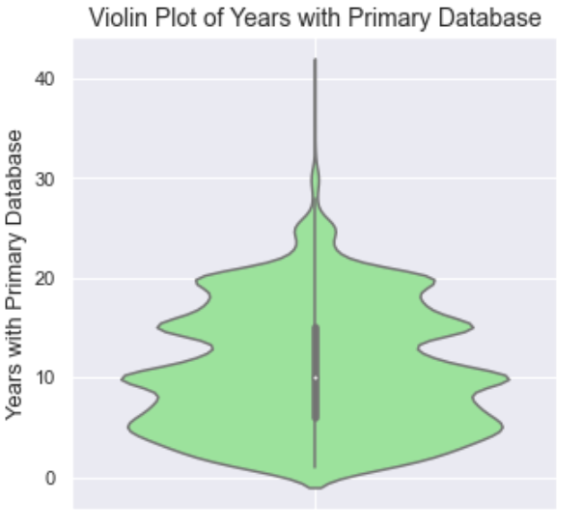
Data Preparation and Analysis (continued)
Years with Database Variable
Violin plot after extreme outliers were removed. This is much better for further analysis!

Slide 23
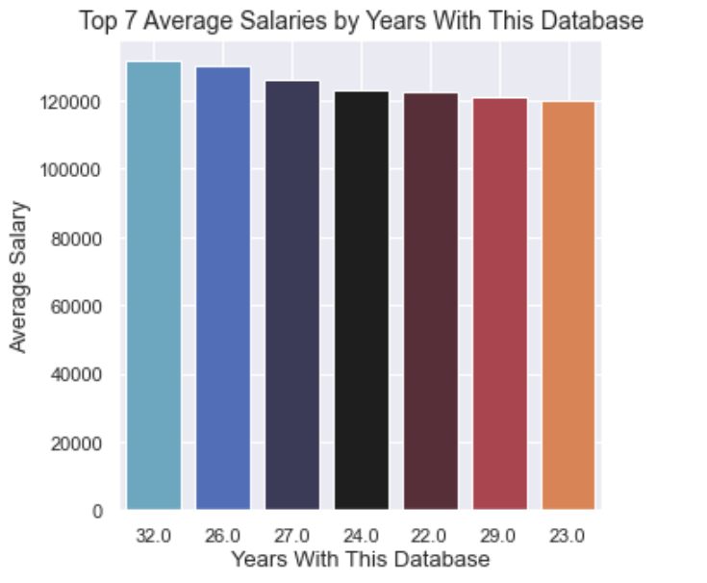
Data Preparation and Analysis (continued)
Years with Database by Salary Average
As expected, experience matters!

Slide 24
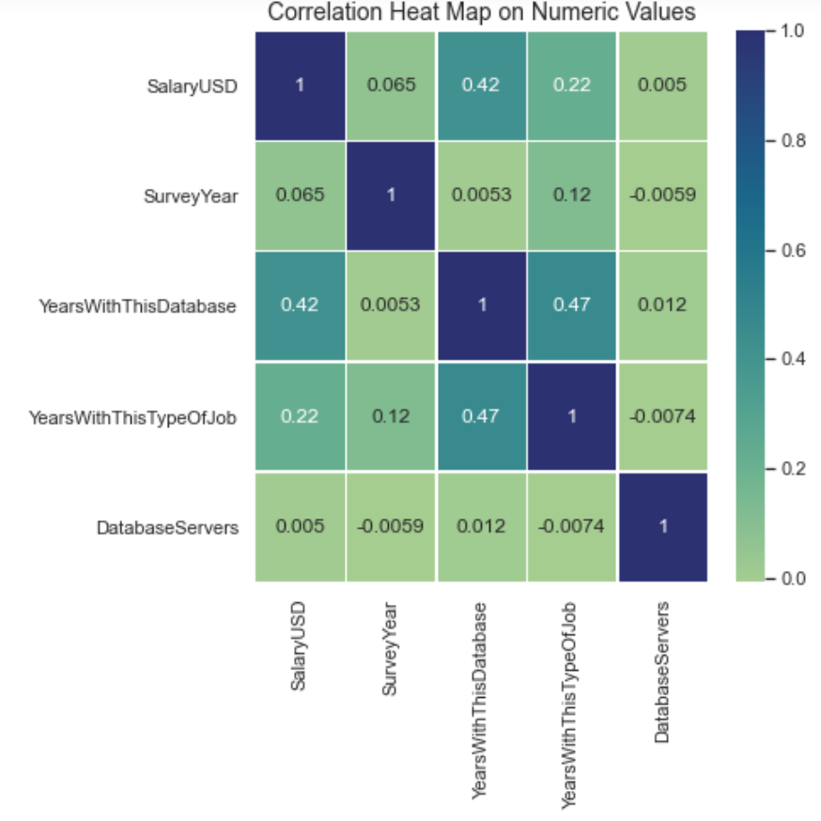
Data Preparation and Analysis (continued)
Numeric Values Heat Map
1 = complete correlation
The numbers closer to 1 indicate that variables are correlated to one another.

Slide 25
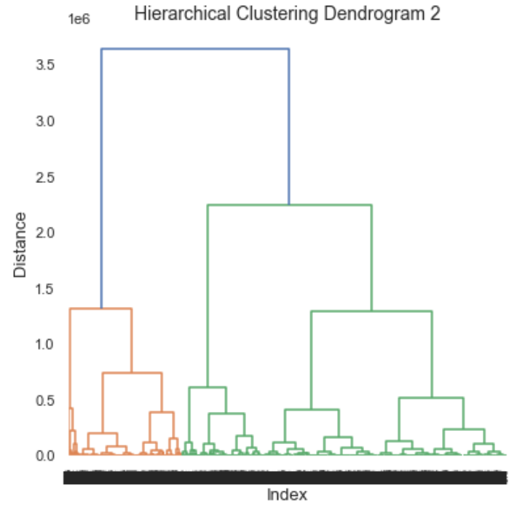
Data Preparation and Analysis (continued)
Cluster Analysis
Often used in marketing analysis (think good customer, average customer, bad customer), the horizonal line indicate 5 distinct clusters.
1
2
3
4
5

Slide 26
Data Preparation and Analysis Summary
After removing missing values and handling outliers, data sparsity was 6% -- this indicates that around 95% of the scrubbed dataset was now useful

Slide 27
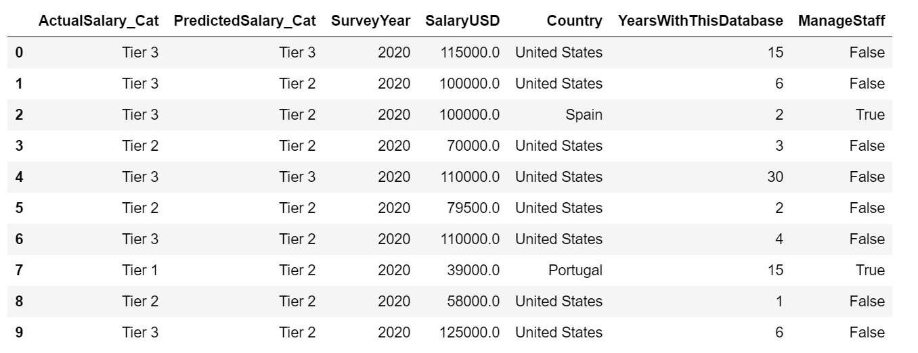
Findings
Random Forest Prediction Method Results
After splitting into 5 salary categories, the Random Forest machine learning model predicts with an accuracy of 63%, thereby confirming the original hypothesis.

Slide 28
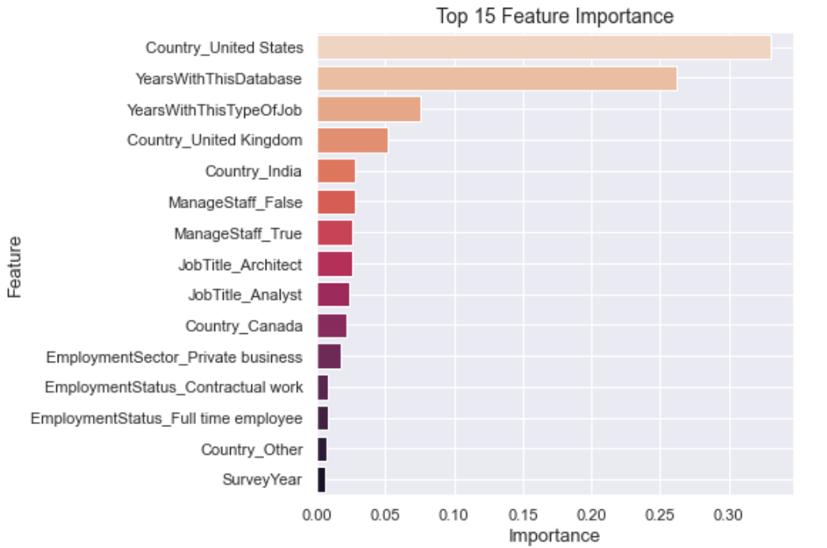
Findings (continued)
Random Forest Prediction Features
The top three variables which had the most impact on the Random Forest selection process was United States and experience variables.

Slide 29
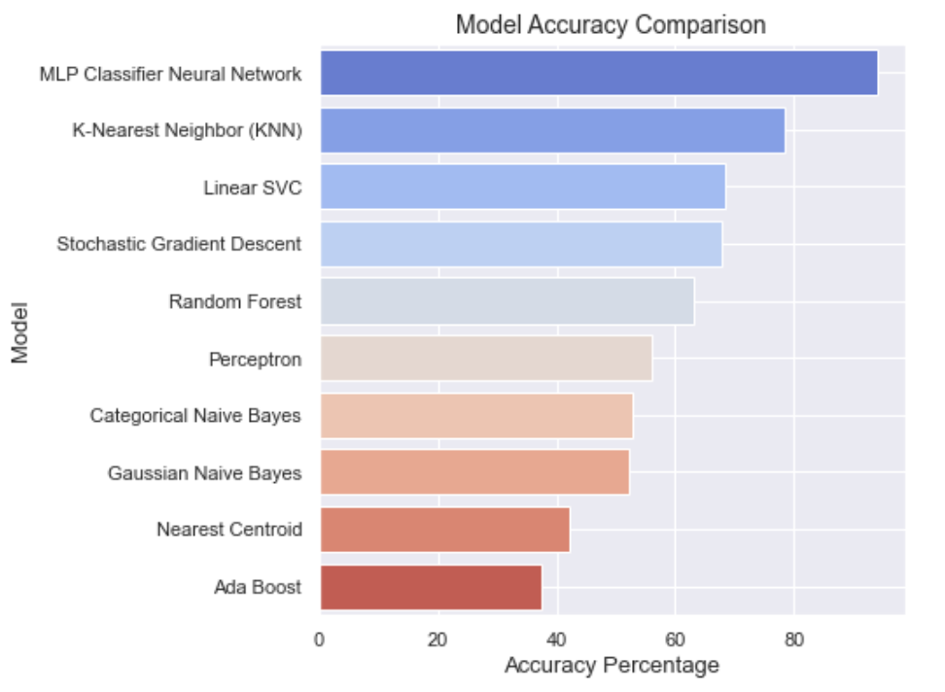
Findings (continued)
Comparing Different Machine Learning Models
While Random Forest does work, there are other models that are more accurate.

Slide 30
Proposed Actions
Implementation of more accurate model
Use a much larger dataset than the one used or wait for the accumulation of more years of data
Use a dataset that isn’t a survey and therefore more accurate

Slide 31
Data Professional Salary Prediction Tool
This is an implementation of one proposed action (implementation of more accurate model)
Chosen for its speed and accuracy
Web tool essentially takes the KNN model and takes input from the user to predict their salary in the future
Provides WGU and its students real value in predicting their salary while also showing a finished capstone product

Slide 32


Slide 33
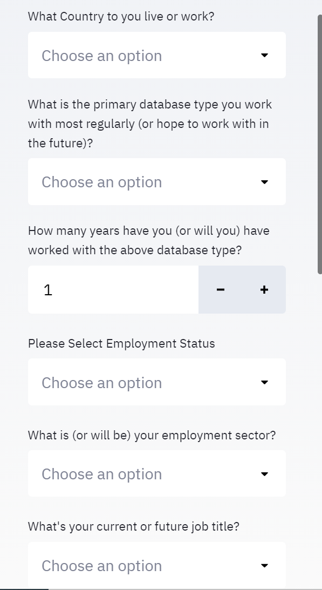
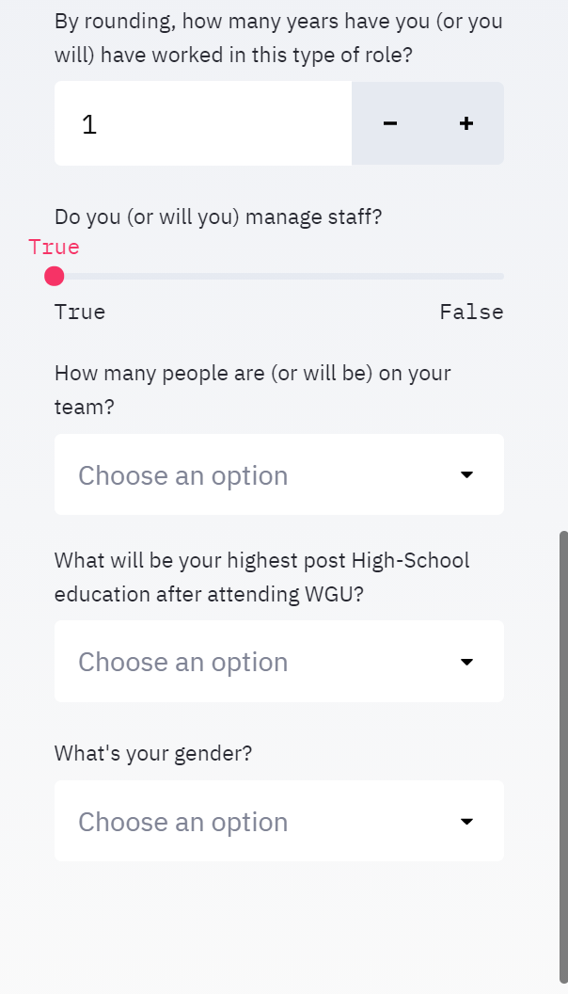
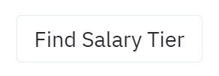
Data Professional Salary Prediction Tool (input selection)
Accurately answer the inputs on the left-hand side of the screen. Try and base your answers at the time of degree completion or two years from today. Then press the button below to initiate the machine learning model prediction. Note: Make sure to input all value variables in order to get a prediction. Additionally, erroneous values will cause an error (aka 100 years, etc.).

Slide 34
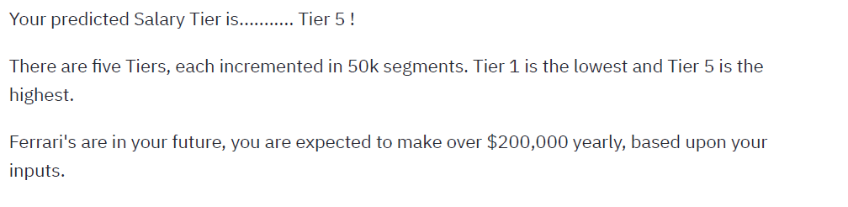
Data Professional Salary Prediction Tool (example prediction)

Slide 35
Summary of Benefits
Provides WGU and their students real value
Increases accuracy of prediction by 15+%
Allows WGU Data Professional Students predict their salary pay band post-graduation
Enables synergy by allowing Data Analytic Masters students at WGU to experience hands-on an example of a machine learning tool carried through to production

Slide 36
Acknowledgments
Dr. William Sewell
WGU Team

Slide 37
Thank you!

